Slide 1

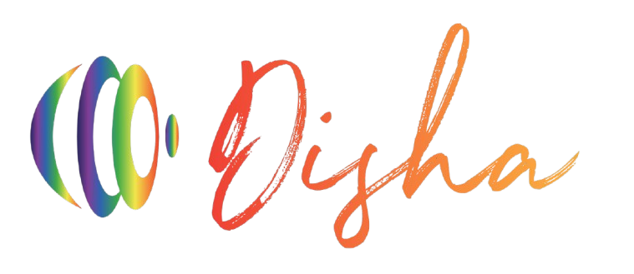
INDIAN INSTITUTE OF INFORMATION TECHNOLOGY, NAGPUR
Department of Computer Science and Engineering
First Project Presentation on
Supervisor: Dr. Mangesh Kose
Enrollment No. and Name of Student:-
BT21CSE161 Lakshit Upreti
BT21CSE188 Abhishek Kumar
BT21CSE194 Gyanbardhan

Slide 2

Contents
Identification of Project/Problem Statement
Whats new in Disha?
Functionalities
Our Progress so far
Literature survey
Work Flow
Fine Tuning LLM
Retrieval-Augmented Generation

Slide 3

Identification of Project/Problem Statement
Introduction:
Information Overload! Today, in this digital age, finding the right information can be a daunting task. It was observed that navigating our website at college was a painful task. Students and visitors, alike, would find it difficult to find the right information—especially when the timetables were divided into badly managed resources like this puzzle with missing pieces.
Here comes Disha!!
Disha is our innovative solution. Imagine asking questions in a normal friendly way and getting instant answers! With the power of Machine Learning, Natural Language Processing and Large Language Models at its core, this simple conversational chatbot will make the user experience on our college website better and deliver quick, convenient responses on every query about our college-from current students to prospective visitors.
With Disha, we make things easier and save precious time for all of us using it. "Let's make accessing information a piece of cake!

Slide 4
Functionalities
Human-Like Interaction:
With Disha, users can ask questions naturally, just like speaking to a person. Whether it’s a simple inquiry or a detailed query about the college, Disha will responds with ease, providing accurate and helpful answers. The chatbot will be designed to make conversation feel smooth and intuitive.
Multilingual – Converse in Hindi and English:
Disha breaks language barriers! Users can ask their questions in both Hindi and English and receive accurate responses in the same language. This makes Disha accessible to a wider audience, including both local and international users.
Voice Command – Ask Your Query Just by Speaking:
No need to type—just tap and speak! With voice query functionality, users can ask their questions in Hindi or English by simply talking to Disha. Whether you're typing or speaking, Disha will provide quick, relevant answers, making the interaction more convenient and user-friendly.

Slide 5
Literature survey
Chatbot Development for Accounting Firm: Fine-Tuning with Novel Datasets:
Objective: Develop a chatbot for accounting firm automation.
Methodology: Fine-tune LLMs using ADE (tax) and ITACA (legal) datasets.
Results: Fine-tuned models outperform existing models, thanks to novel datasets.
Impact: Reduces manual workload, provides fast, accurate legal/fiscal info.
Conclusion: Dataset creation and LLM fine-tuning enhance chatbot capabilities in specialized domains.
Link:
https://webthesis.biblio.polito.it/secure/31058/1/tesi.pdf

Slide 6

Literature survey
Leveraging LLMs for Enhanced RAC Accessibility:
Objective: Simplify RAC using LLMs.
Dataset: 24,478 labeled Q&A pairs.
Methodology: Data extraction, labeling, model training (GEMMA 1.1).
Results: V8 model excelled, average rating 7/10, RAC 3 needs improvement.
Impact: Reduces expert reliance, improves compliance, and accessibility.
Conclusion: LLMs can revolutionize RAC understanding.
Link:
https://arxiv.org/pdf/2405.08792

Slide 7
Literature survey
Fine-Tuning LLMs in Ophthalmology and GPT-4-Based Evaluation:
Objective: Evaluate clinical alignment of LLM-generated responses.
Fine-tuning: 5 LLMs (GPT-3.5, LLAMA2 series) for ophthalmology.
Methodology: Dataset of 400 Q&A pairs, GPT-4 evaluation.
Results: GPT-3.5 top performer (87.1% accuracy), LLAMA2s followed.
Agreement: High correlation between GPT-4 and human clinician rankings.
Conclusion: GPT-4 is a promising evaluator, LLMs need improvement for clinical use.
Closing Thought: LLMs have potential in ophthalmology, but accuracy and reliability are crucial.
Link:
https://arxiv.org/pdf/2402.10083

Slide 8
Literature survey
Smart Chatbot Architecture for Healthcare:
Introduction: Chatbots for healthcare assistance.
Challenges: Limitations of rule-based systems.
Proposed Architecture: NLP, ML for intelligent conversation.
Technological Components: NLU, NLG, ASR.
Healthcare Application: Reduces burden, offers personalized responses.
Link:
https://dl.acm.org/doi/10.1145/3386723.3387897

Slide 9
Literature survey
RAG-Based Chatbot for PDF Queries:
Objective: Answer queries from PDFs using LLMs and RAG.
Technology: Python, PyTorch, LangChain, Hugging Face, Chainlit.
Methodology: Data preprocessing, text segmentation, embeddings, vector store.
Key Components: LLM models (Llama2-7B, GPT-3.5), RAG system, user interface.
Results: Efficient, contextually accurate responses, web application.
Conclusion: Improved response accuracy, scalability for future development.
Link:
https://ijsrem.com/download/rag-based-chatbot-using-llms/

Slide 10
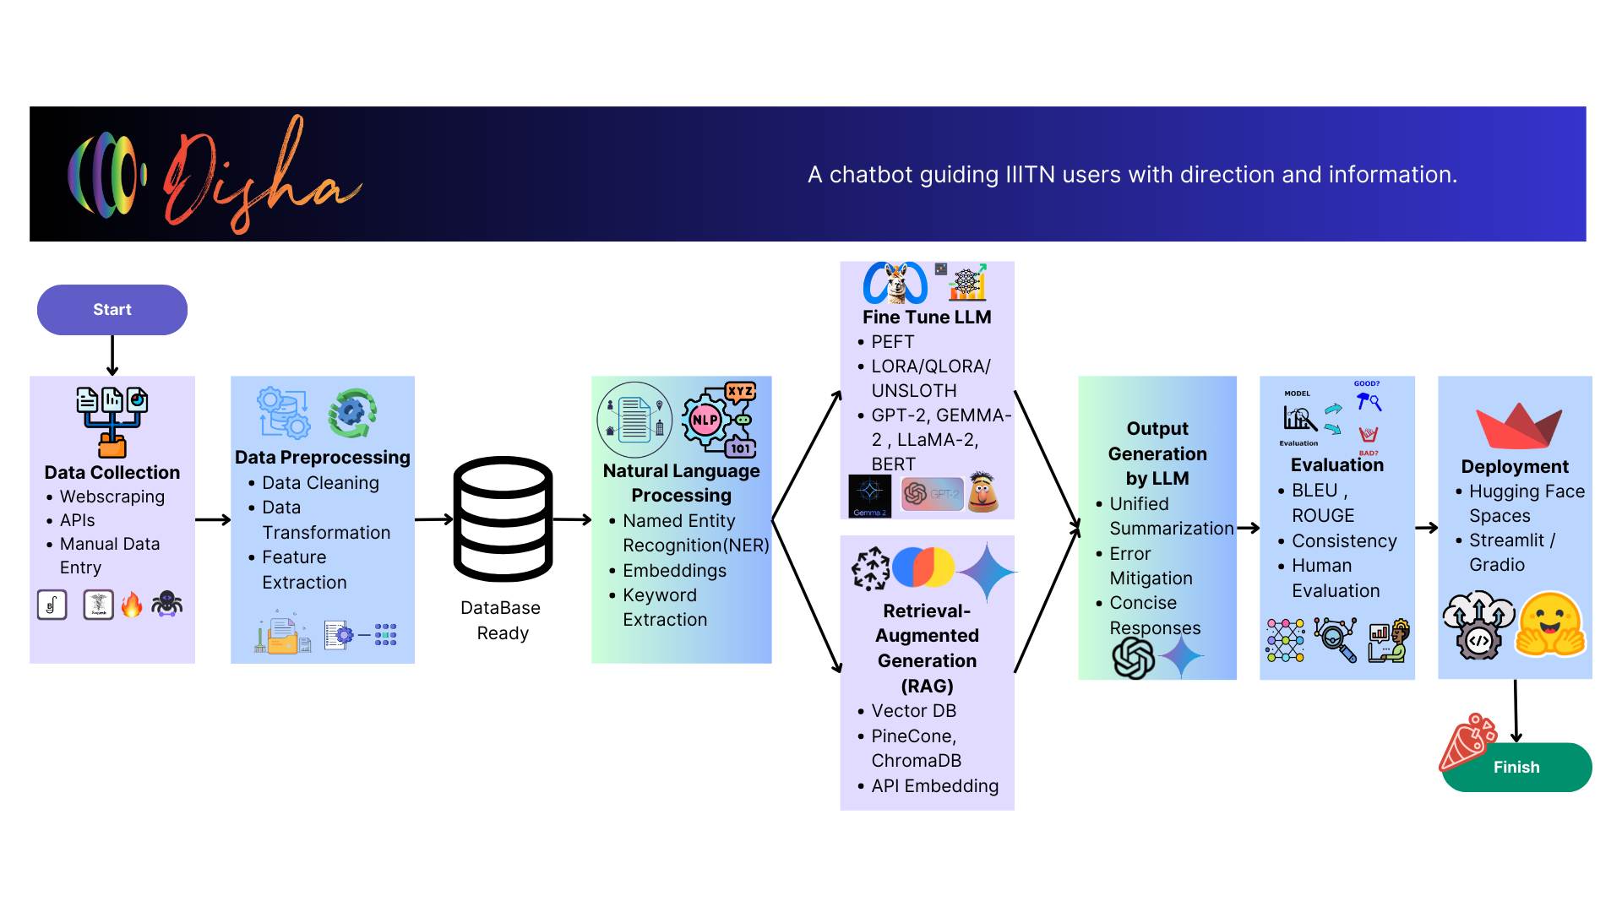

Slide 11
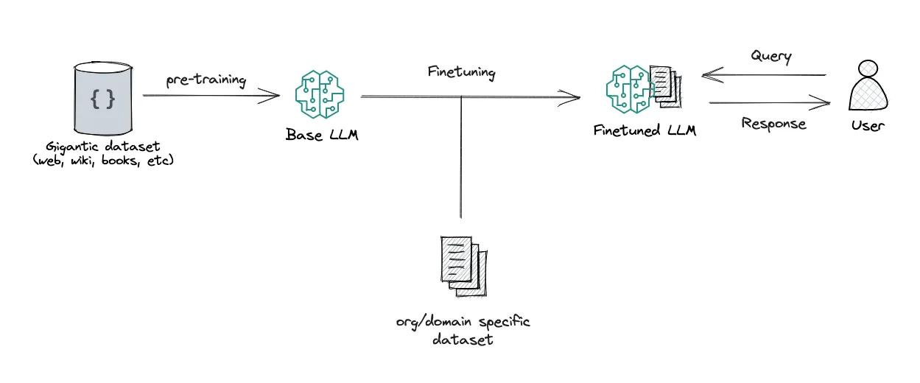

Fine Tuning LLM
GPT-2
LLaMA-2
Gaama-2
BERT
IIITN Dataset
Fine-tuning is the process of adapting a pre-trained model to a specific task or dataset by adjusting its weights. It's essential here to tailor the chatbot for IIITN-specific queries and ensure accurate, relevant responses.
Data from IIITN website will be fed into the model.
Models: BERT, GPT-2, LLaMA2, Gamma2.
PEFT - LoRA, QLoRA, Unsloth techniques will be used.
Customization for accurate, IIITN-specific answers.
Open-source models ensure flexibility and scalability.

Slide 12
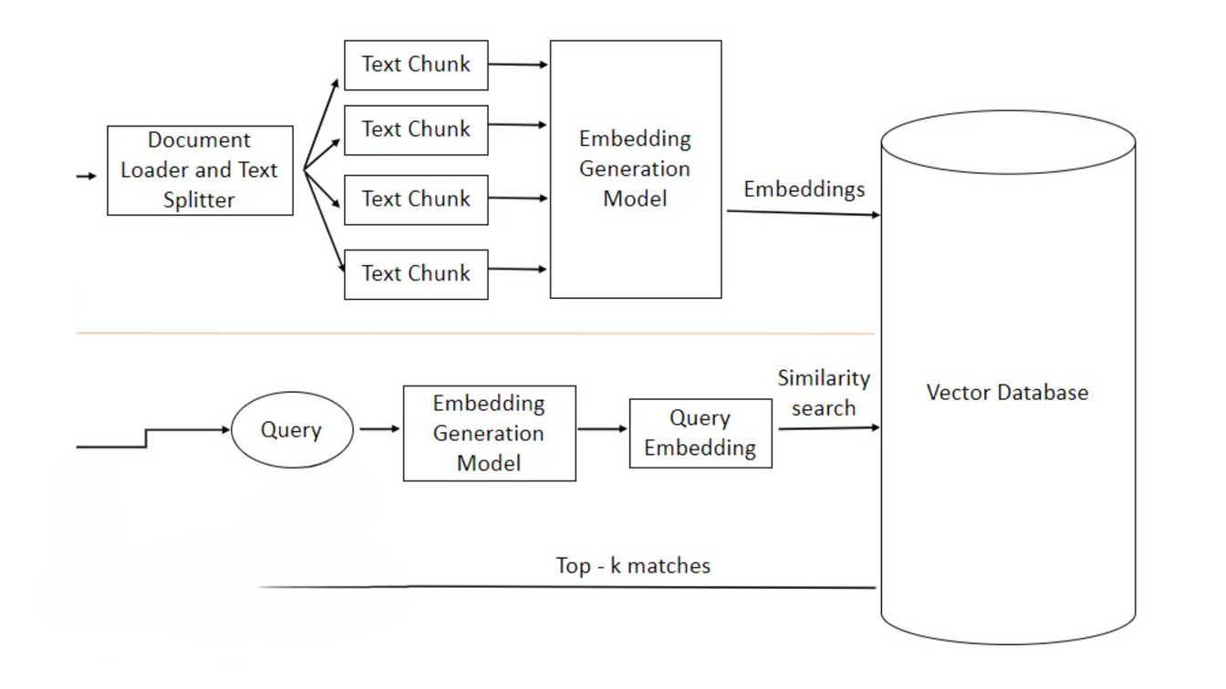
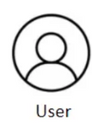
Retrieval-Augmented Generation
RAG is a hybrid approach where a model retrieves relevant information from an external database before generating an answer. This enhances the model's response by grounding it in accurate, up-to-date data.
PineCone and ChromaDB will be used for efficient data storage and retrieval.
Gemini's free API will be used for LLM output.
Langchain will be used for creating Pipeline for Database and LLM.
IIITN Dataset
Pinecone
ChromaDB
LLM
Google Gemini

Slide 13
Whats new in Disha?
Unified Intelligence: Merging RAG and LLMs for better Results:
Our project combines Retrieval-Augmented Generation (RAG) with Fine-Tuned LLMs trained on our college data. and a Summarizing LLM that unifies both outputs into one cohesive response, delivering clarity and precision.
Key Innovations:
Unified Responses: Summarizing LLM merges best information from both, RAG systems and fine-tuned LLMs.
Context Preservation: Critical details from all sources are maintained for accuracy.
Robust and Reliable: Facts are double-checked i.e., responses fetched by RAG are compared with the response from LLM model fine-tuned on our college website data, ensuring high reliability.
Natural Flow: Tailored, user-friendly language enhances the conversation.
With this innovative architecture, Disha offers smarter, clearer, and more intuitive responses, creating a superior user experience!

Slide 14
Our Progress so far
Data Collection – Gathering Information:
One of the most crucial steps in our project is collecting the right data. We’ve already completed most of our data collection, primarily through web scraping, to gather all the necessary information from our college website. This data will form the backbone of Disha’s knowledge, ensuring accurate and relevant responses.
Data Preprocessing – Cleaning and Refining the Data:
We are now working on preprocessing the collected data, applying various techniques to clean, organize, and structure it for optimal use. This step ensures that Disha can efficiently process and retrieve information, making sure users get fast and accurate answers every time.
"With clean, well-processed data, Disha is set to deliver a seamless, intelligent experience!"

Slide 15


